Slide 1
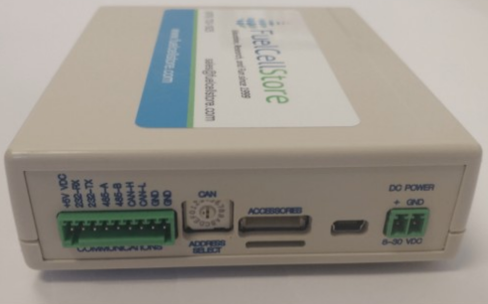
Team 36:
Fuel Cell Monitor
Update Presentation 03/07
Nolan Kao
Mingoo Jung
John Henderson

Slide 2
Project Overview
The Fuel Cell Monitor (FCM) will be able to monitor up to sixteen cell voltages simultaneously and display them on a mobile application.

Slide 3
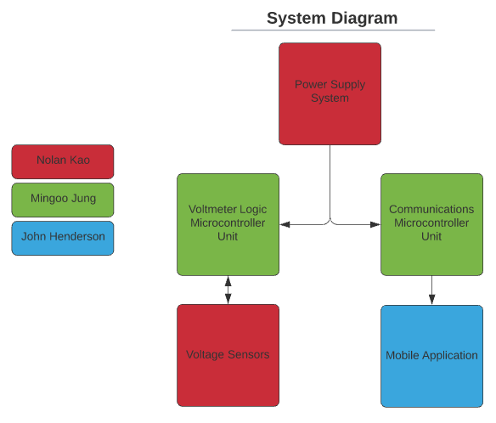
FCM System Diagram

Slide 4
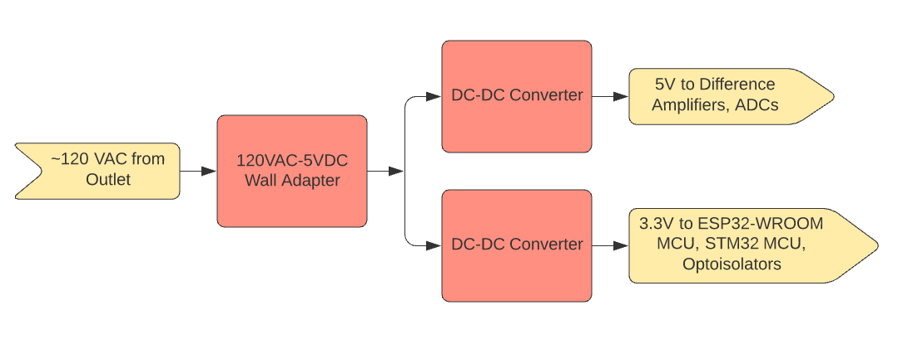
Power Supply Subsystem Diagram

Slide 5
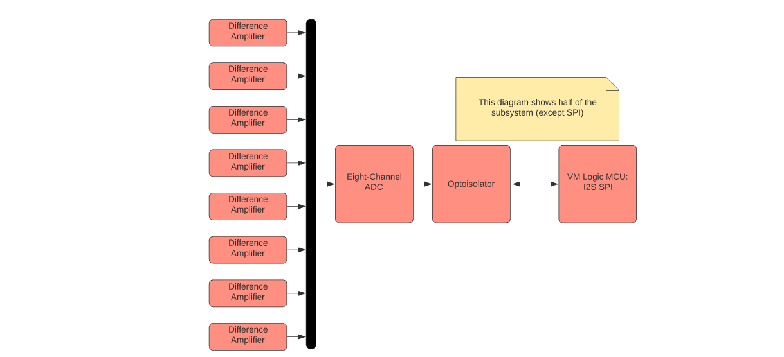
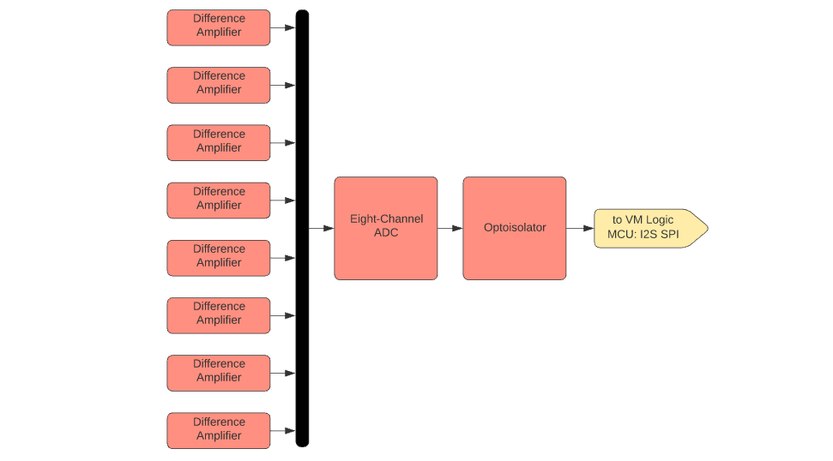
Voltage Sensor Subsystem Diagram

Slide 6
Power Supply Characteristics
120VAC to 5VDC wall plug supplies power to PCB power supply
PCB power supply has two different output source voltages: 3.3V and 5V
3.3V goes to optocouplers, MCUs
5V goes to difference amplifiers, ADCs

Slide 7
Voltage Sensor Characteristics
Consists of sixteen difference amplifiers, two ADCs, and two optocouplers
Printed on PCB

Slide 8
Update on Power Supply and Voltage Sensors
Nolan Kao
Accomplishments since last week 15 hours of effort | Ongoing progress/problems and plans until next presentation
Soldered most of the PCB. | Validate/test PCB to completion Test MCU functionality with Mingoo

Slide 9
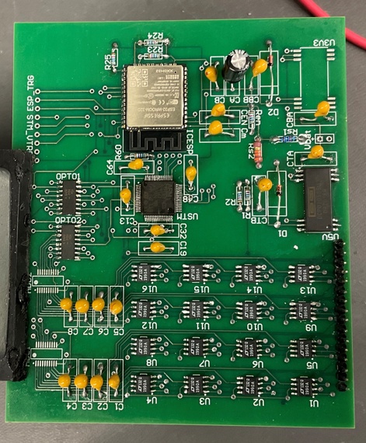
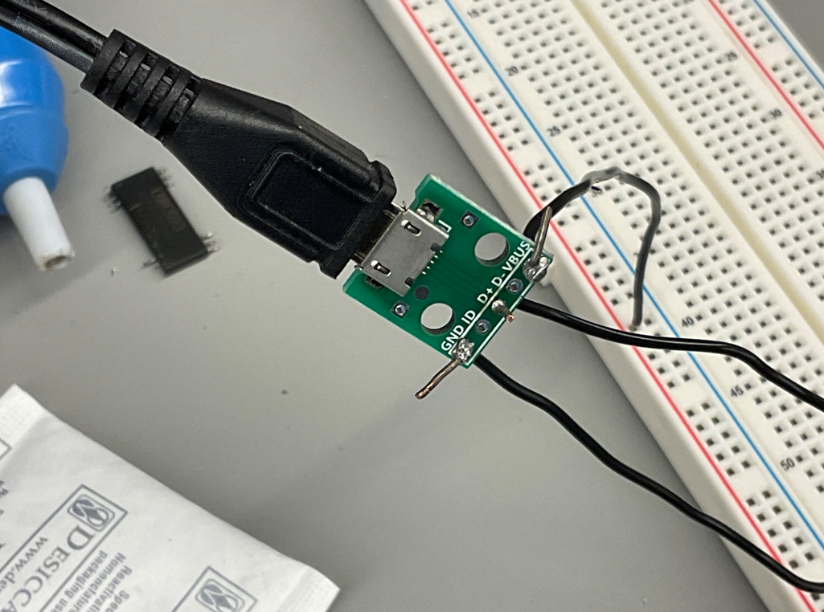
Soldering of Micro-USB to Connector
Mostly-soldered PCB

Slide 10
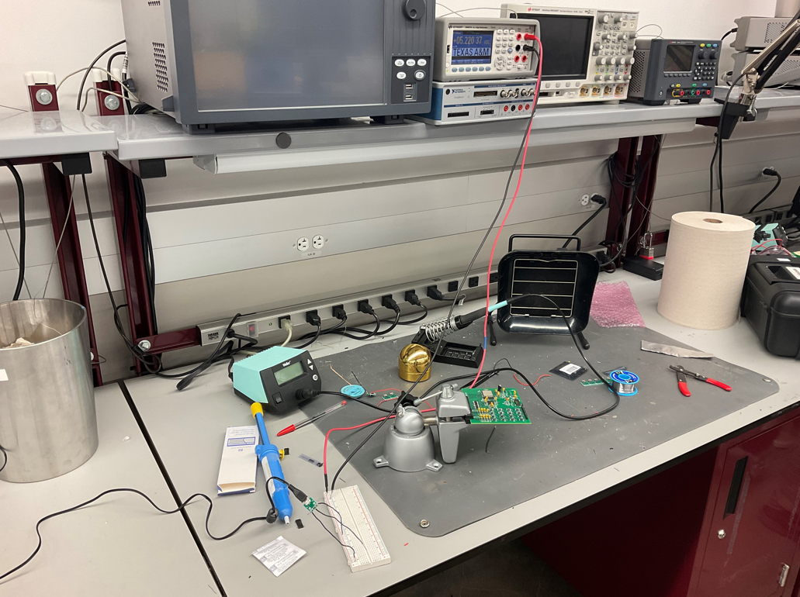
Testing the voltage accuracy of the Micro-USB connector

Slide 11
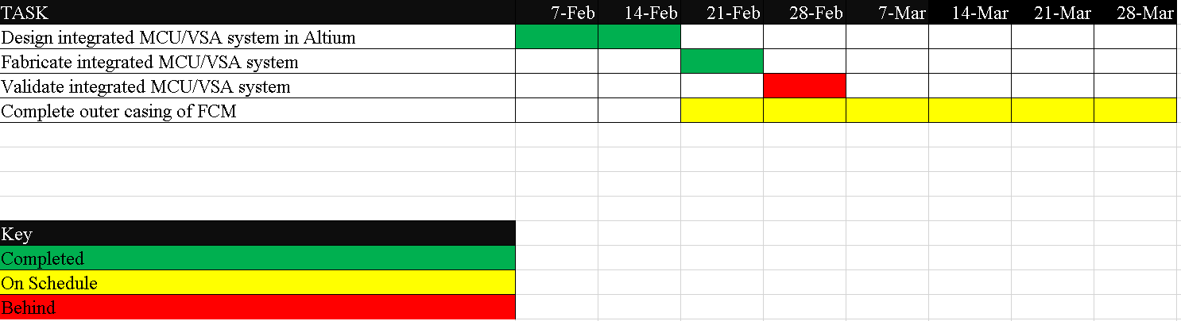
MCU/VSA Schedule

Slide 12
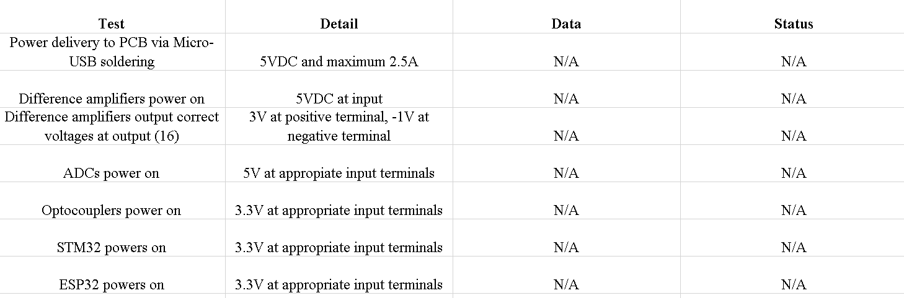
Validation of PCB

Slide 13
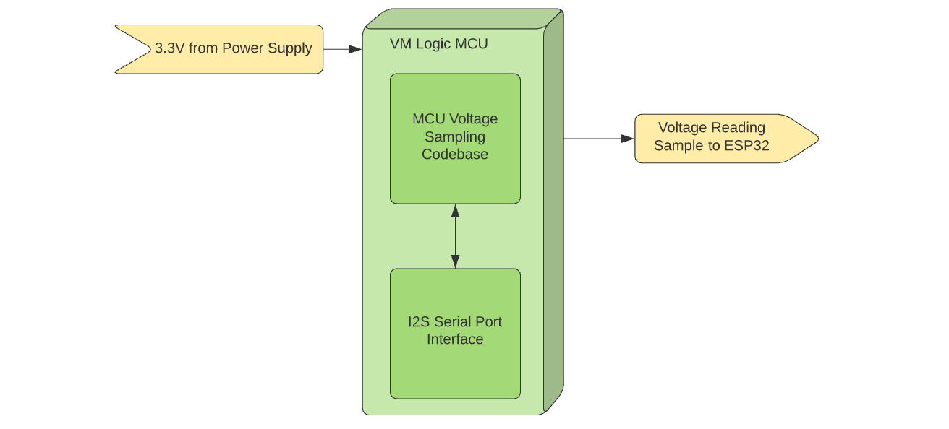
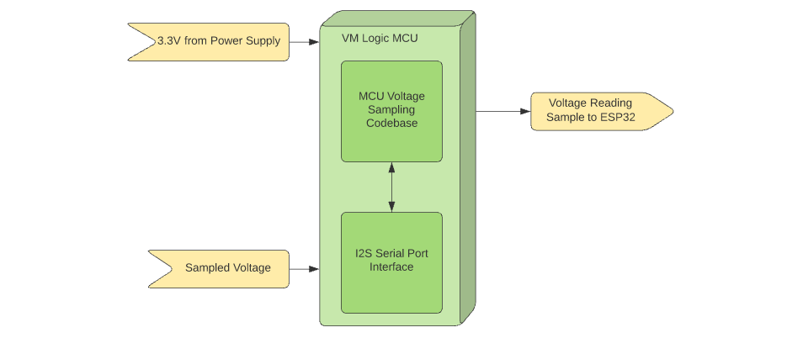
Voltage Logic MCU Subsystem Diagram

Slide 14
Update on MCU Subsystem
Accomplishments since last week 10 hrs of effort | Ongoing progress/problems and plans until next presentation
Finalize to redesign and integrate PCB for MCU, power supply and voltage sensor subsystem Revise code for bluetooth communication between communication MCU and mobile phone | Continue to integration with Smart phone application and the communication MCU data Validate redesigned PCB for MCU, power supply and voltage sensor subsystem Validate code for SPI communication between voltage sensor subsystem and logic MCU

Slide 15
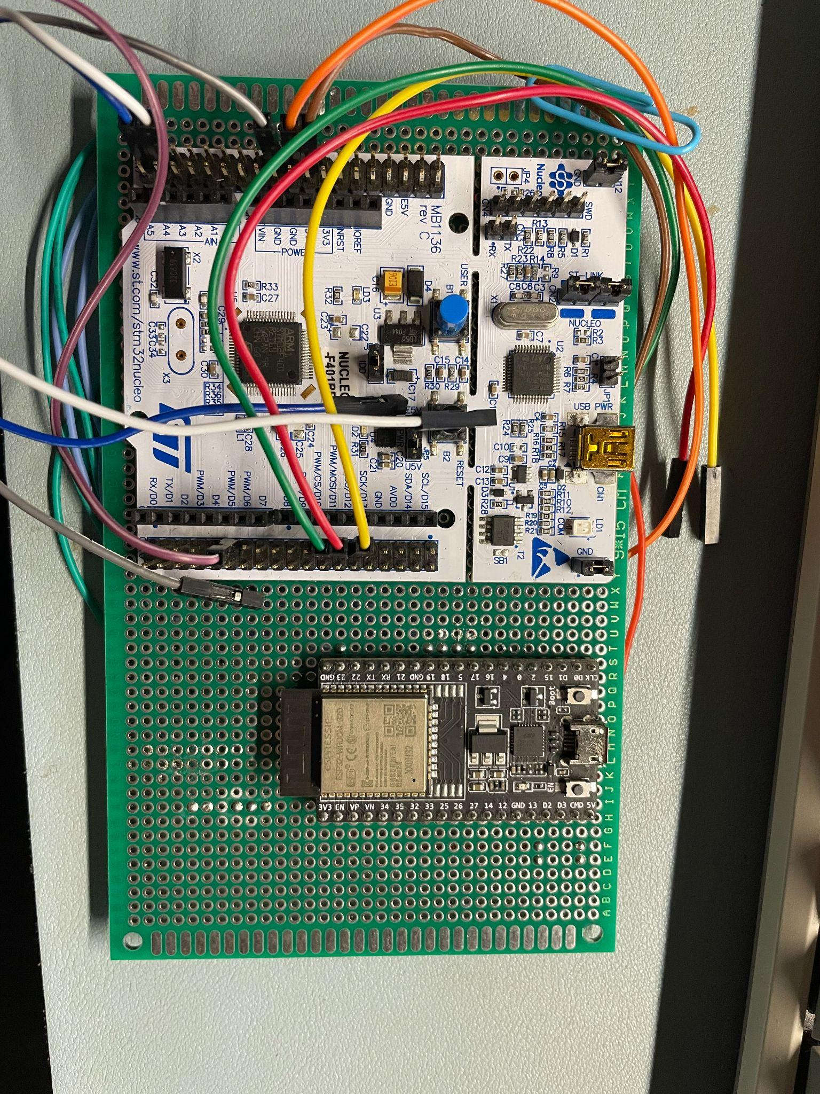
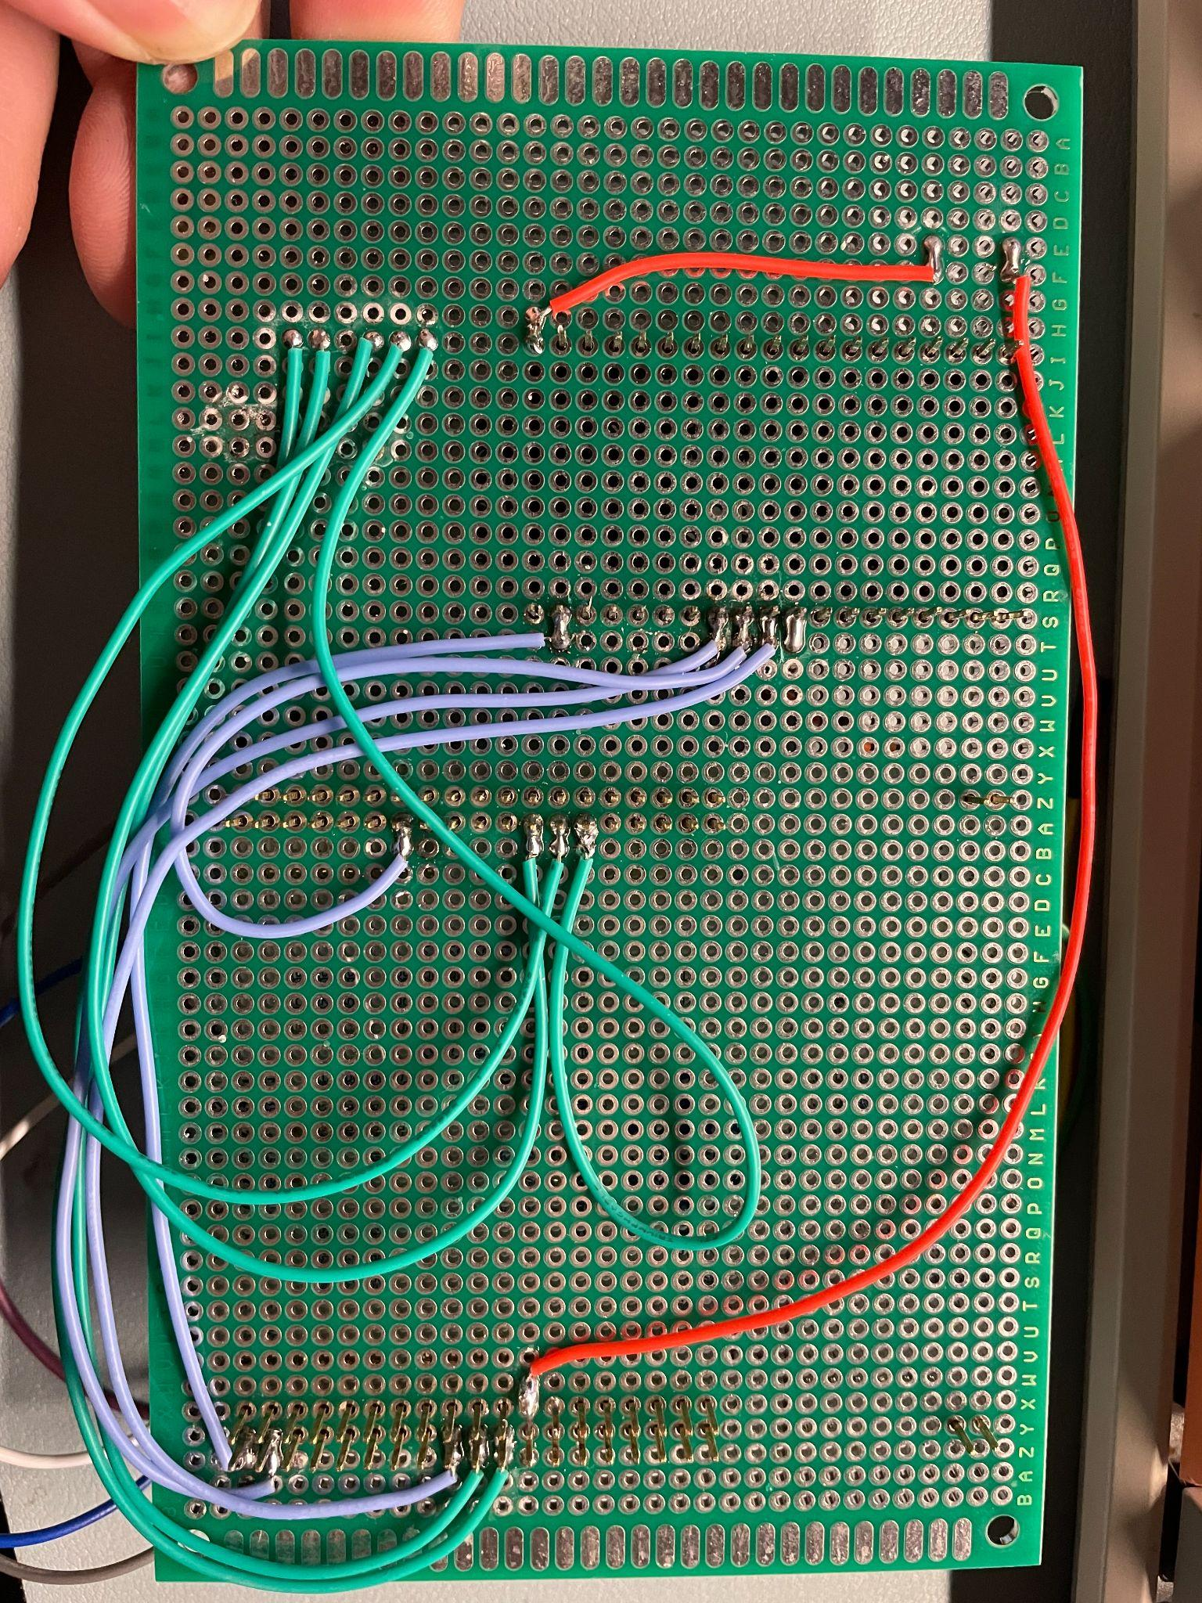
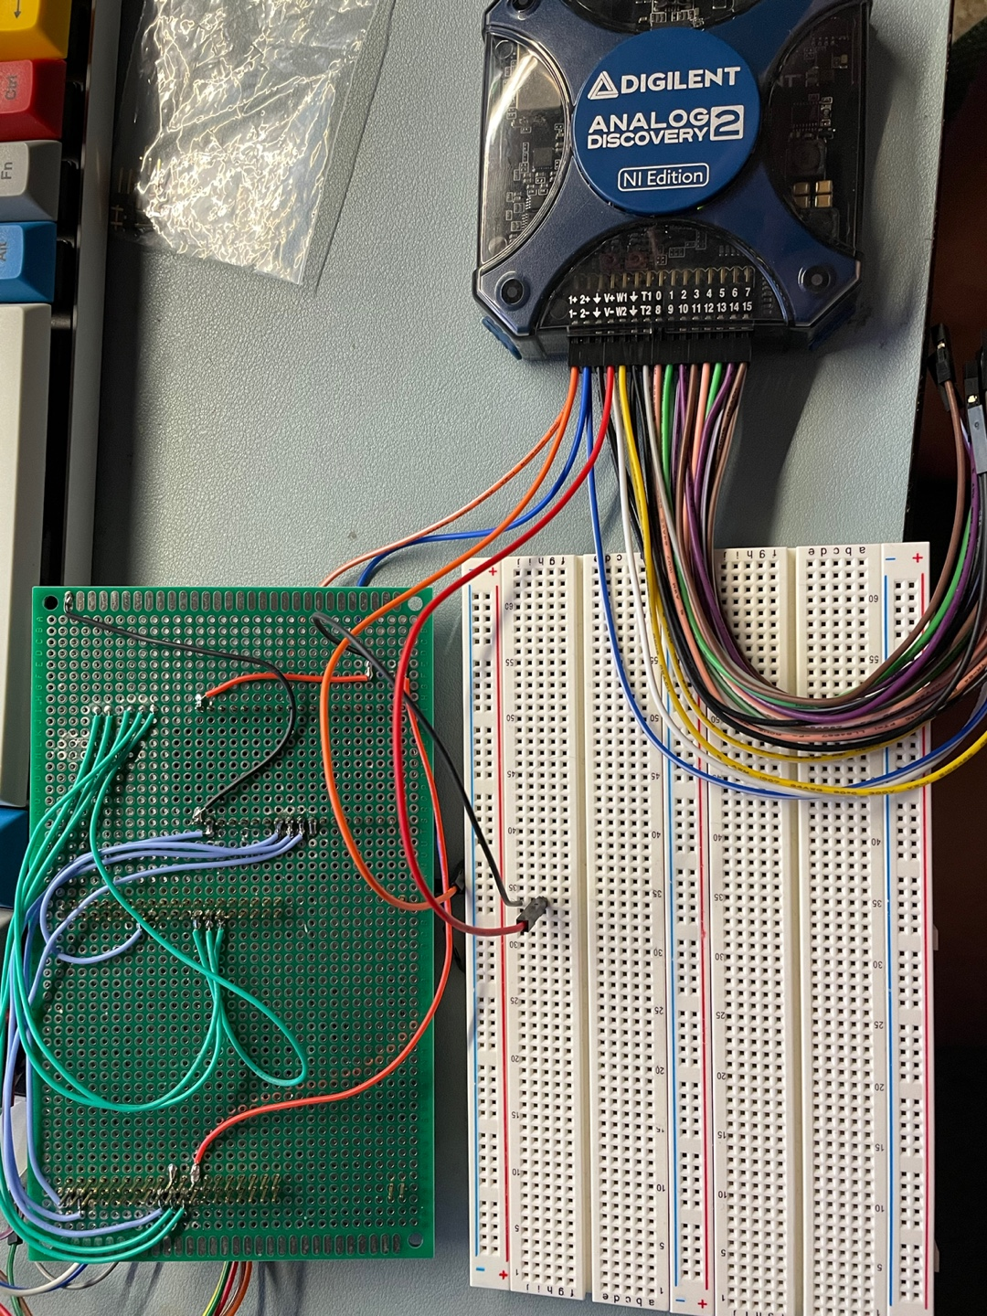
Figure1-1. Actual Wiring between MCUs with soldering
Figure1-2. Actual Wiring between MCUs with soldering
Figure2. Validation for connection between the MCU subsystem and external power supply

Slide 16
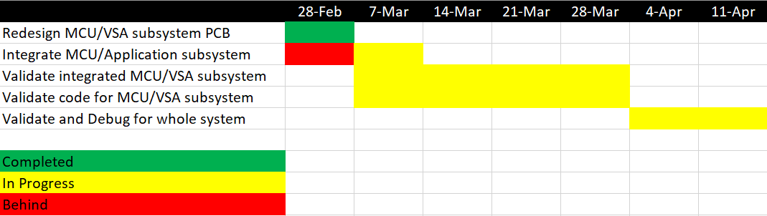
MCU Schedule

Slide 17
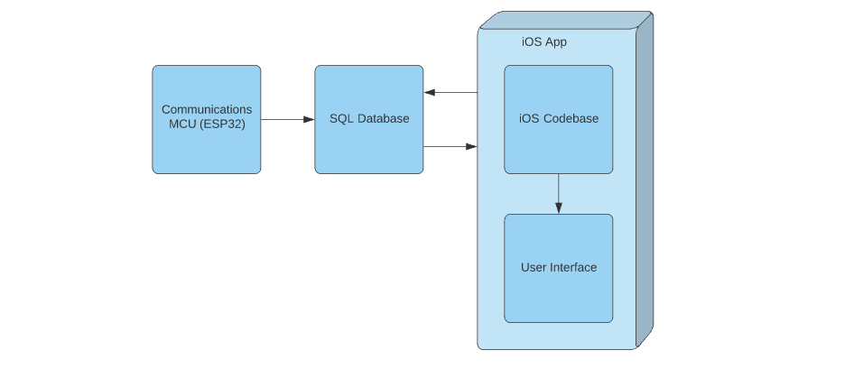
SQL Database and Mobile App Subsystem Diagram

Slide 18
Update on SQL Database and Mobile App
Accomplishments last update 25 hrs of effort | Ongoing progress/problems and plans until next presentation
App fully downloaded onto phone rather than simulator Bluetooth Connections created | Writing Bluetooth functions to scan and identify

Slide 19
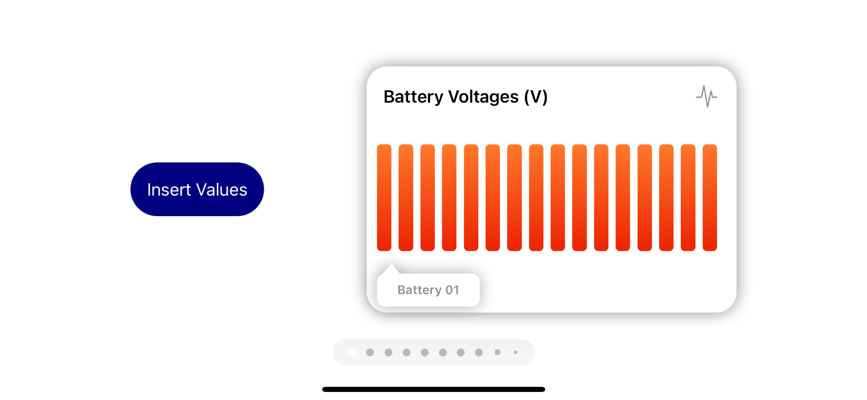
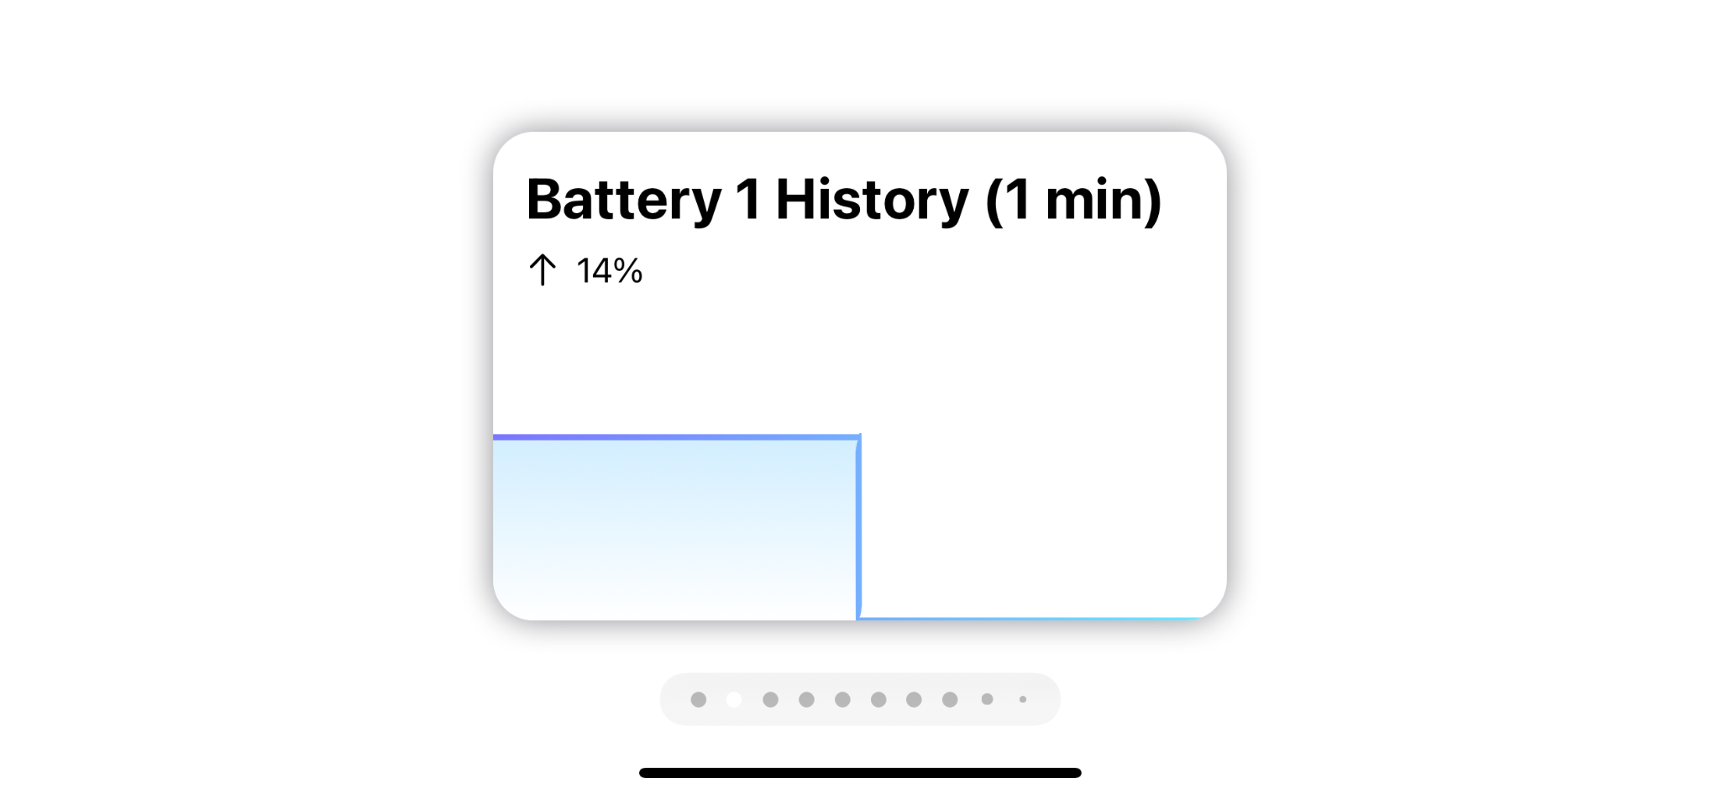

Slide 20
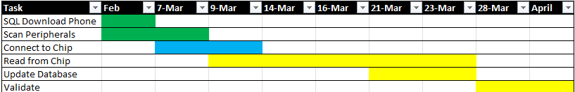
Mobile App Schedule

Slide 21
Thanks for listening!

